Slide 1
DIFFUSION MODELS
CSE 705 SEMINAR (FALL 2024) DAY 1
Presented By:
Team Sushi (Vamshi Krishna Kyatham, Rahul Dasari, Xiaofeng Chen)

Slide 2
WHAT ARE GENERATIVE MODELS?

Slide 3
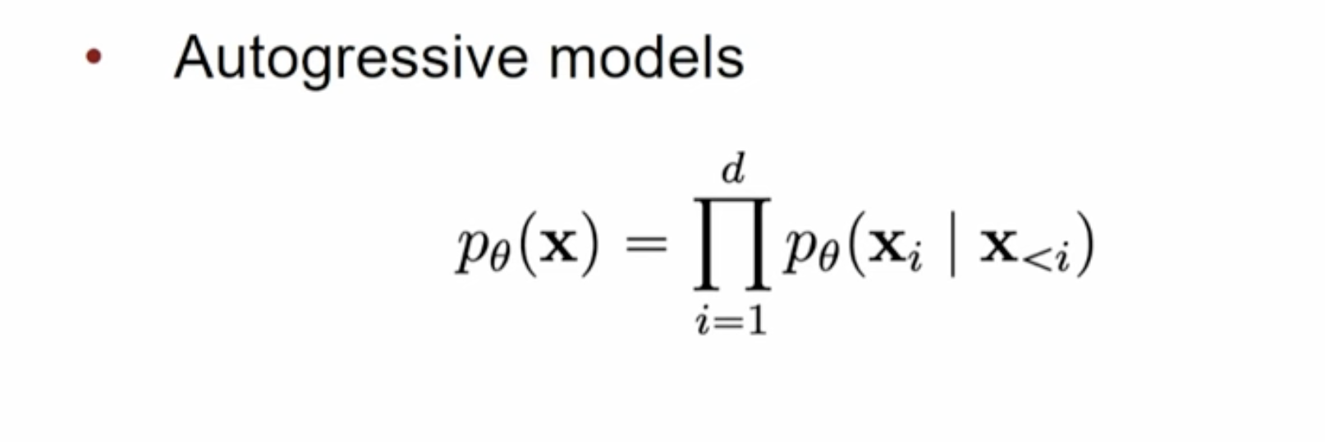
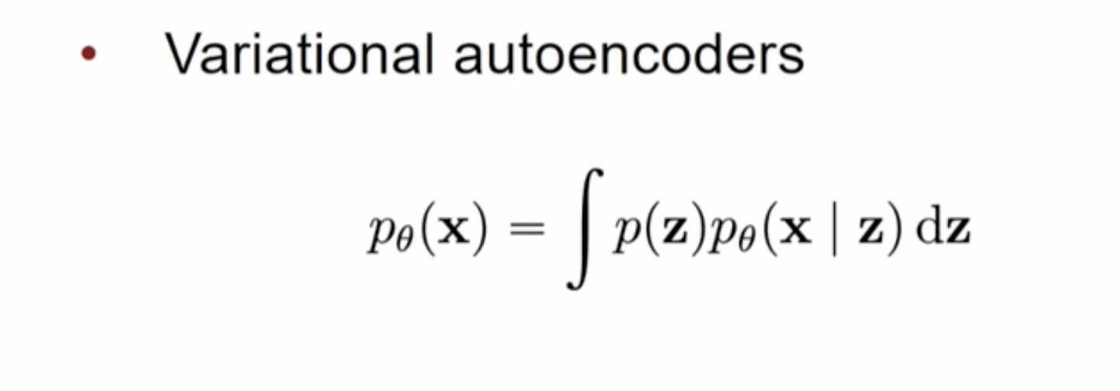
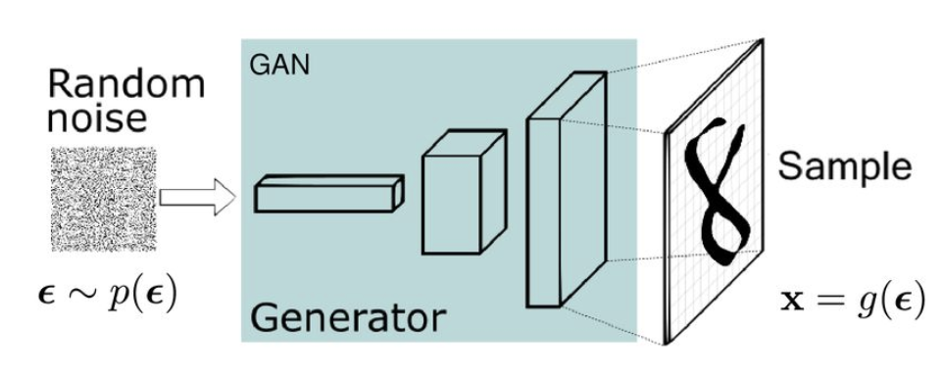
Generative Models
Generative models try to model the probability density function of the data and sample from it or directly sample from the distribution.
Explicit models: (They model the distribution)
Implicit models: (They directly sample from the distribution)
GANs

Slide 4
SCORE BASED GENERATIVE MODELS

Slide 5
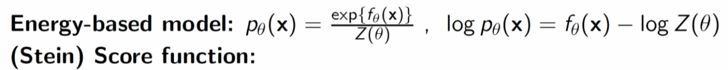
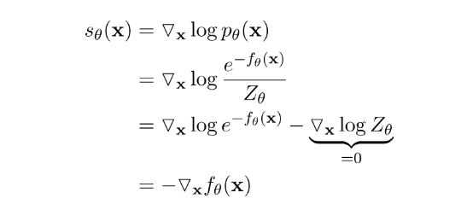
What is Score?
Score is essentially the field of the probability density function

Slide 6
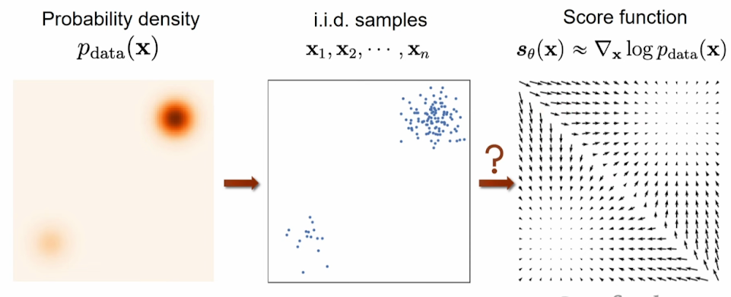
What is score

Slide 7
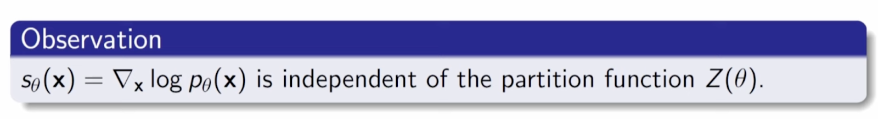
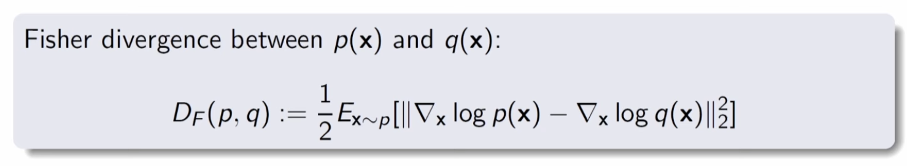
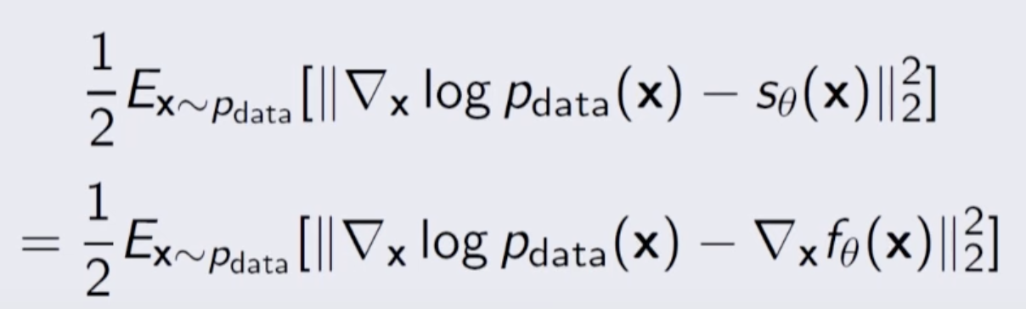
Score Matching

Slide 8
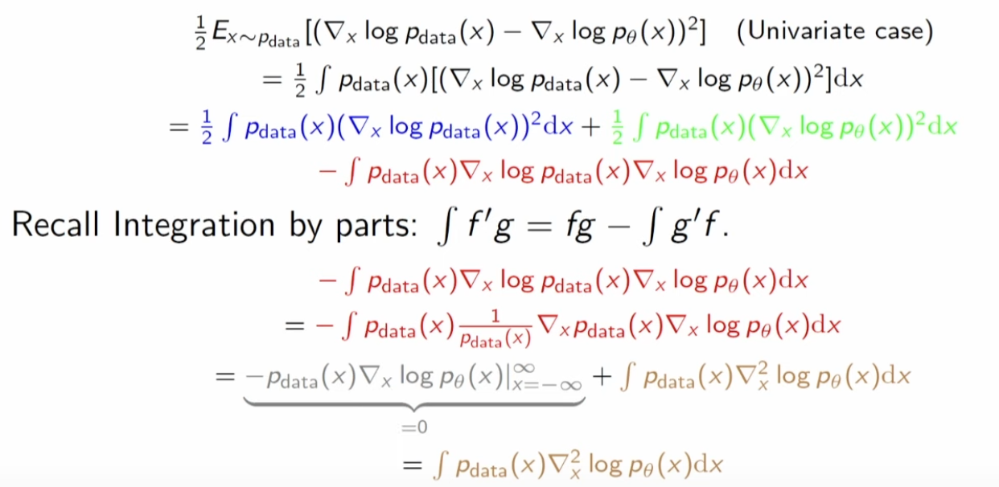
Score Matching

Slide 9
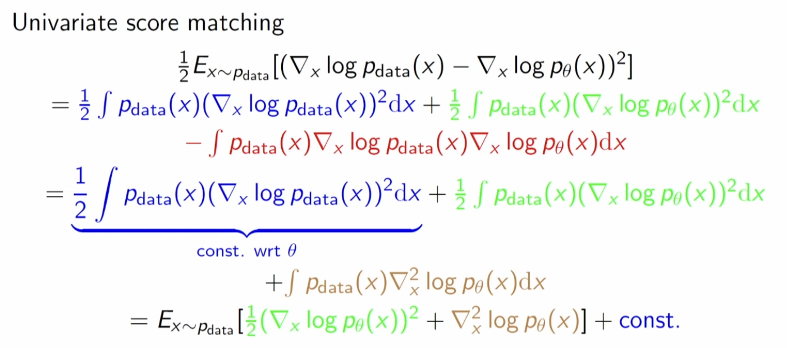
Score Matching

Slide 10
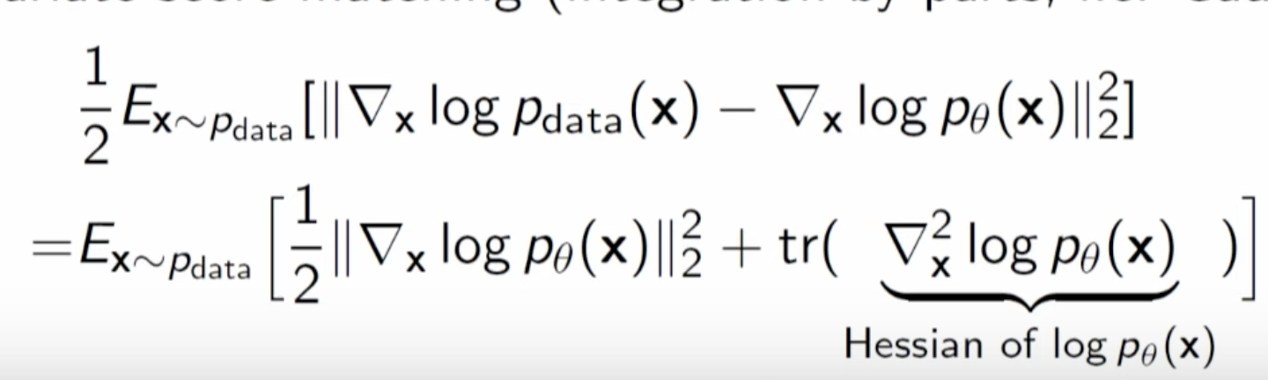
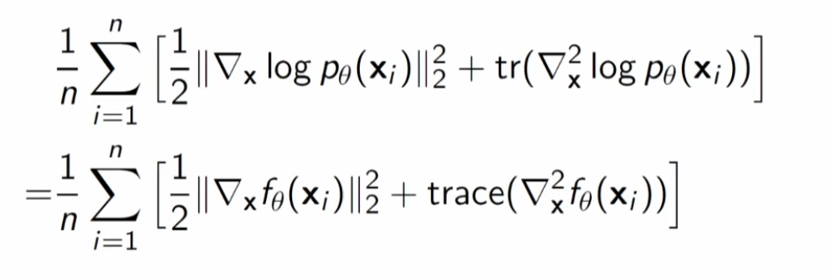
Score Matching for Multivariate case
The derivative of the gradient simplifies to the trace of the hessian of P(x)

Slide 11
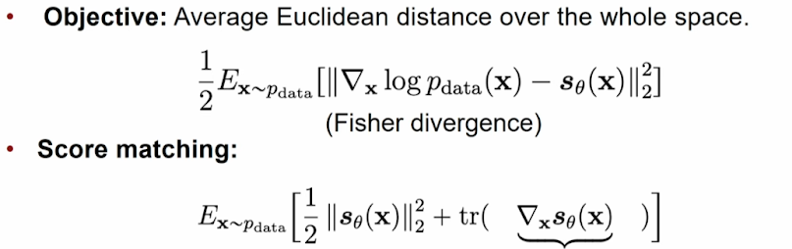
Score Matching
The objective is to maximise fisher divergence by using score matching.
Computing the hessian is expensive

Slide 12
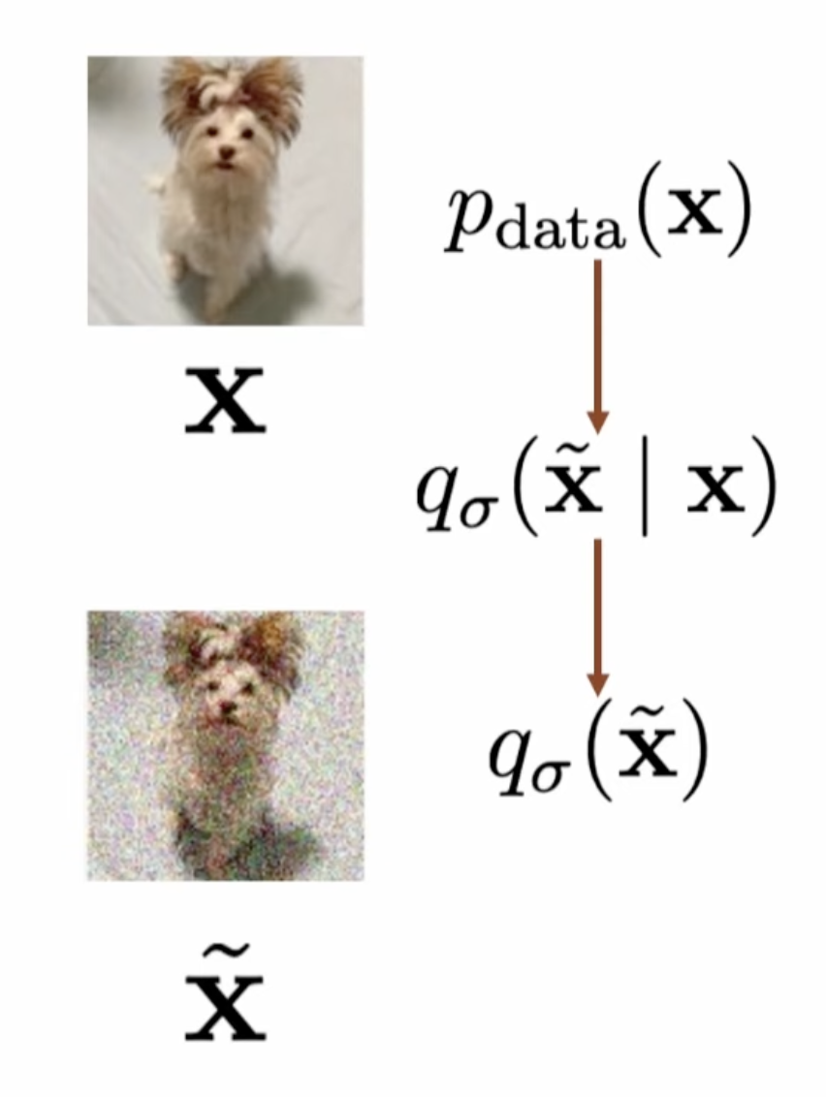
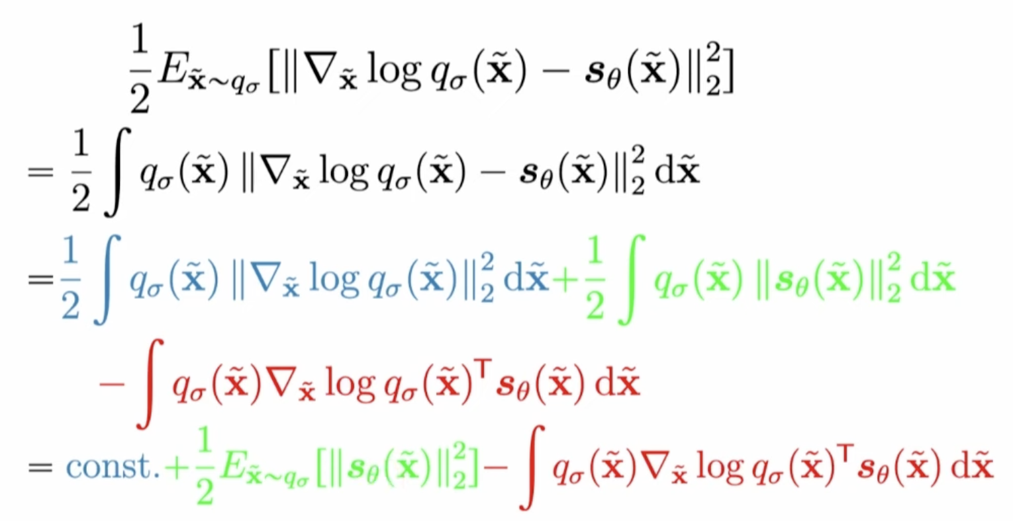
Denoising Score Matching
yet again we try to compute the loss

Slide 13
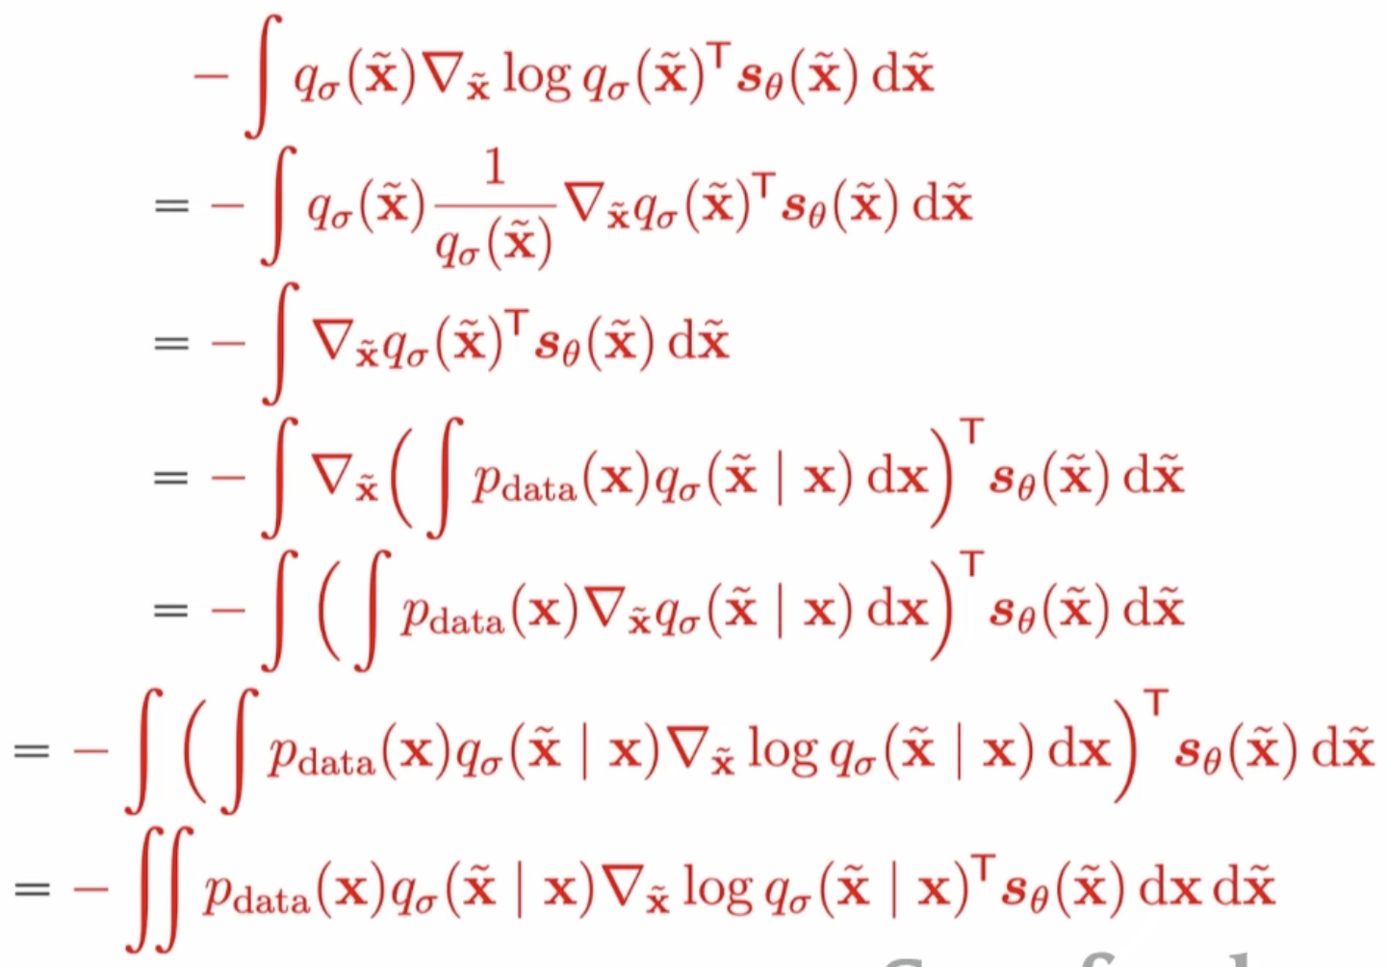
Denoising Score Matching

Slide 14
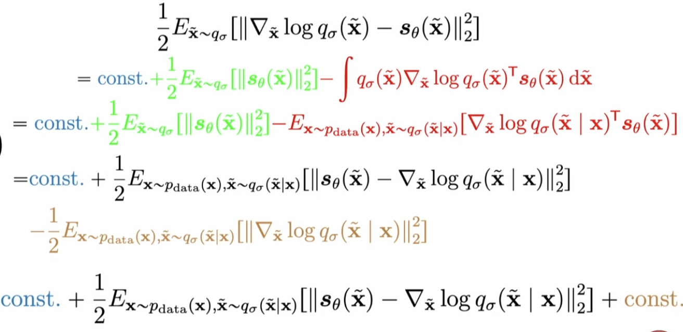
Denoising Score Matching
=

Slide 15
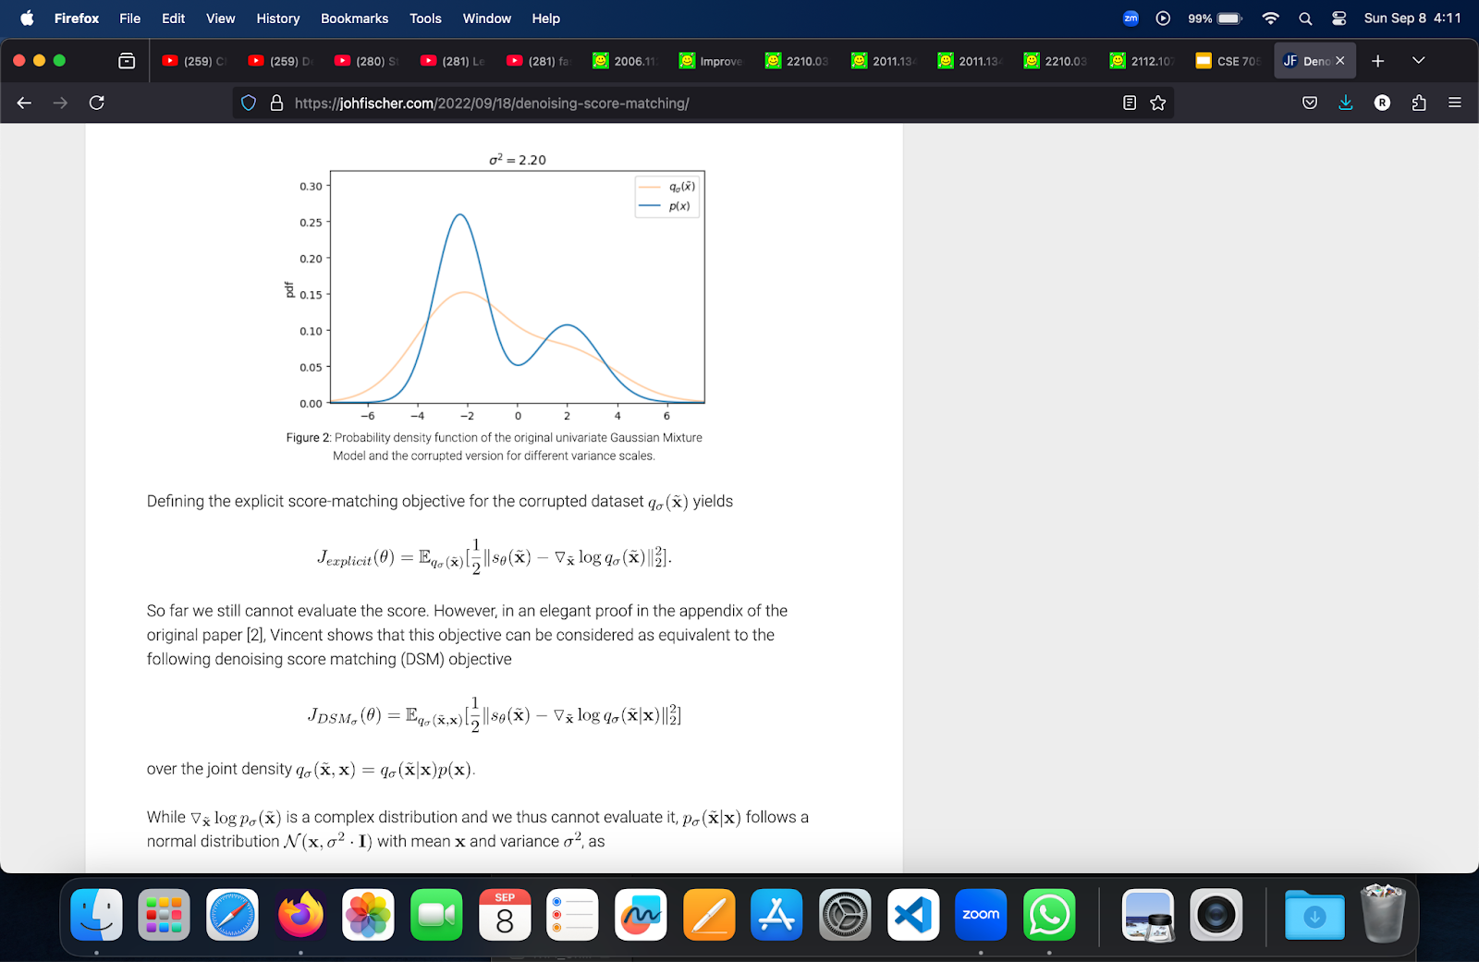
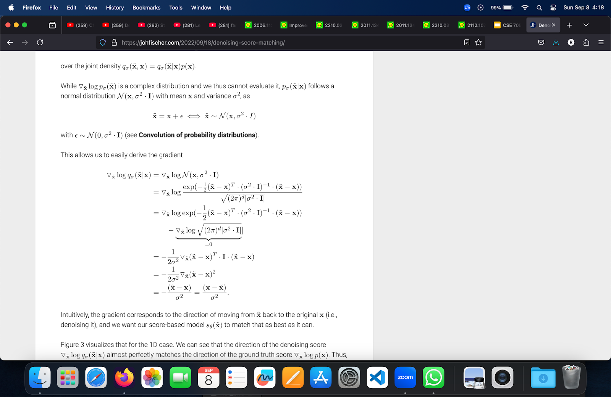
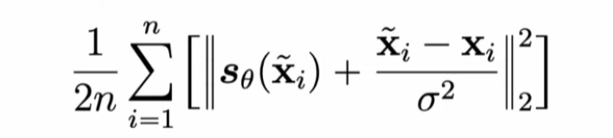
Denoising Score Matching
Loss =

Slide 16
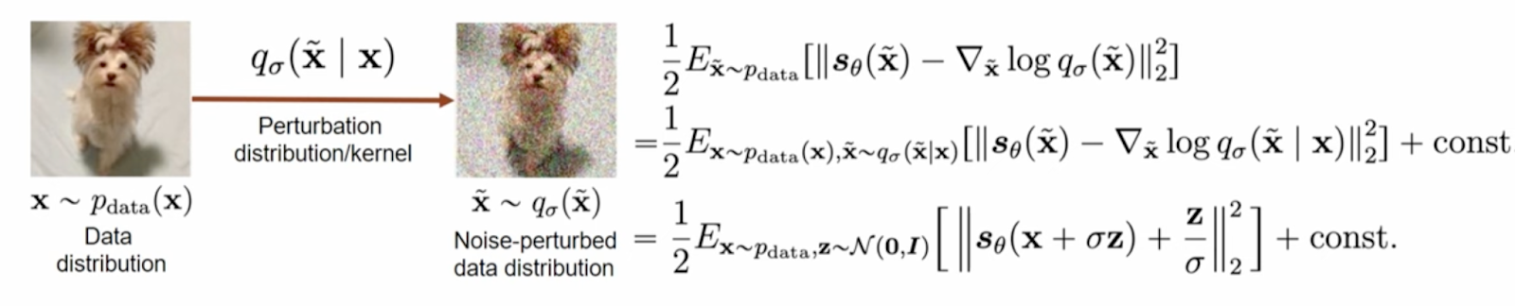
Denoising Score Matching
This formulation avoids computing the hessian, hence its computationally efficient

Slide 17
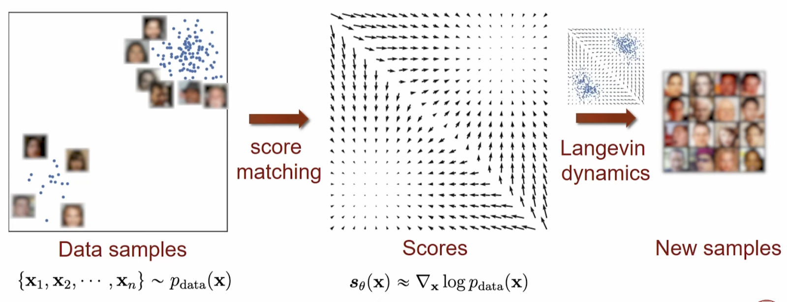
Sampling from a score based model

Slide 18
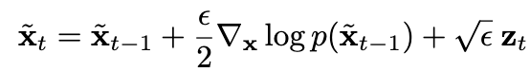
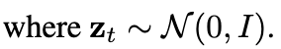
Sampling from a score based model
similar to gradient ascent, except that we add a noise

Slide 19
Challenges of score based Generative Modeling
Now we analyze more closely the idea of score-based generative modeling. We argue that there are obstacles that prevent a naïve application of this idea.
> Manifold hypothesis
> Low density regions

Slide 20
The manifold hypothesis
The manifold hypothesis states that data in the real world tend to concentrate on low dimensional manifolds embedded in a high dimensional space.
Under the manifold hypothesis, score-based generative models will face two key difficulties.
> First, since the score ∇ log p(x) is a gradient taken in a higher dimensional space, it is undefined when x is confined to a low dimensional manifold.
> Second, the score matching objective provides a consistent score estimator only when the support of the data distribution is the whole space and will be inconsistent when the data reside on a low-dimensional manifold.

Slide 21
Low data density regions
The scarcity of data in low density regions can cause difficulties for both score estimation with score matching and sampling with Langevin dynamics.
> In regions of low data density, score matching may not have enough evidence to estimate score functions accurately, due to the lack of data samples.
> When two modes of the data distribution are separated by low density regions, Langevin dynamics will not be able to correctly recover the relative weights of these two modes in reasonable time, and therefore might not converge to the true distribution.

Slide 22
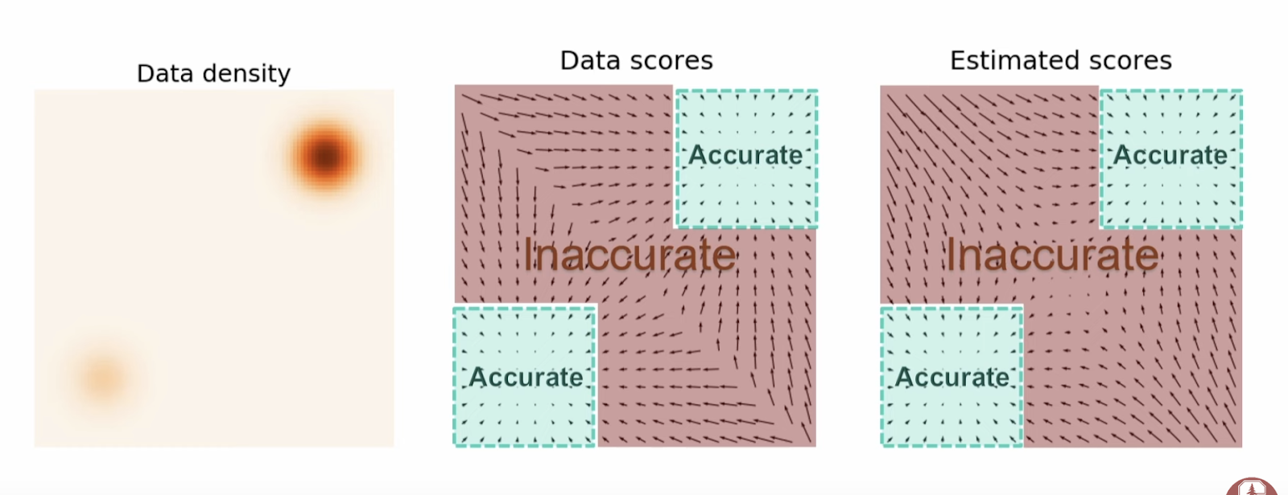
Noise Conditional Score Networks

Slide 23
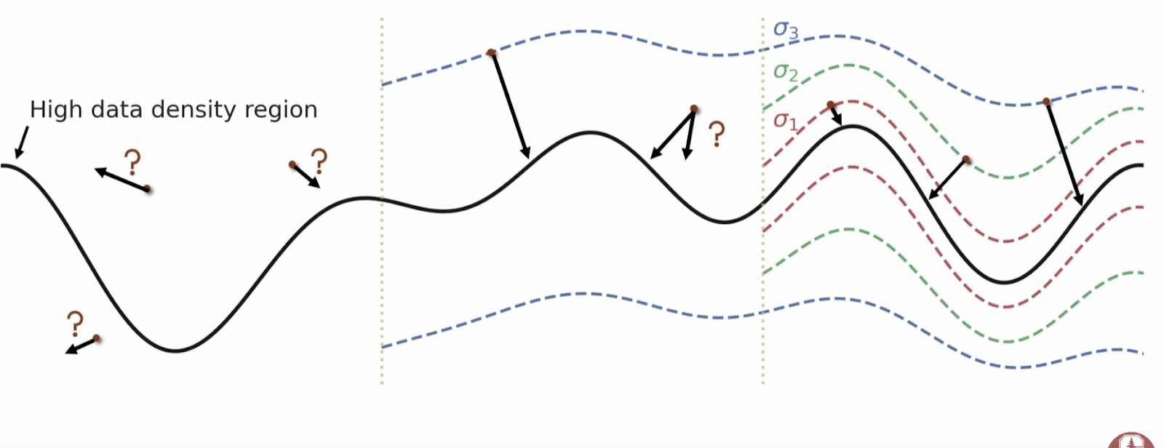
Noise Conditional Score Networks

Slide 24
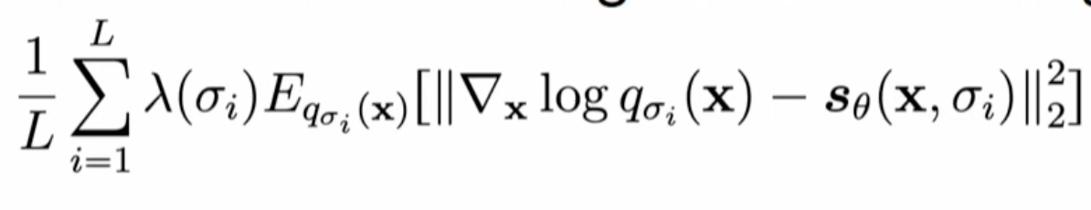
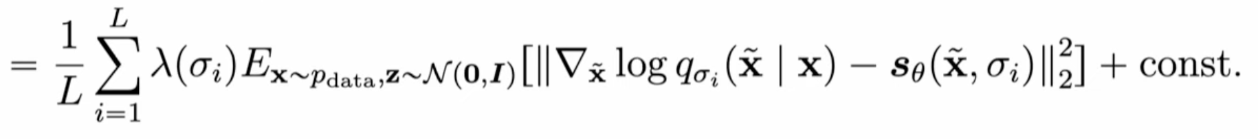
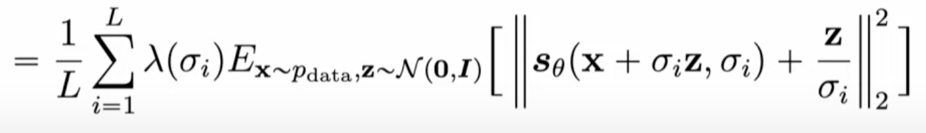
Noise Conditional Score Networks

Slide 25
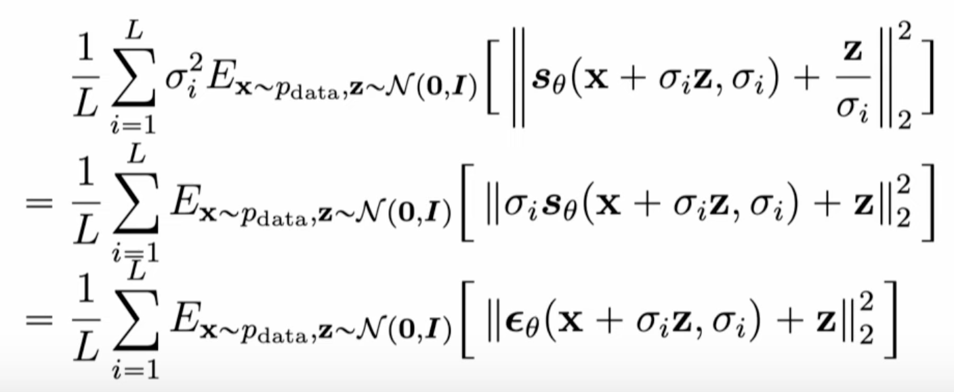
Noise Conditional Score Networks

Slide 26
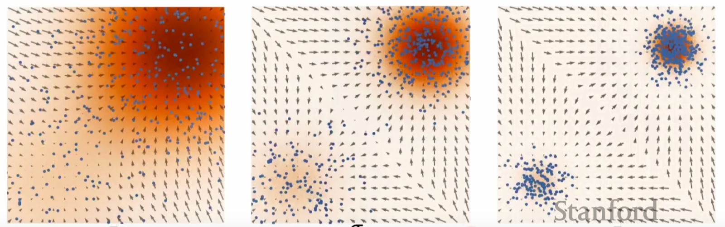
Annealed Langevin Dynamics

Slide 27
Next Up
Denoising Diffusion models. These models don’t use score matching, but instead model the noising and denoising as a markov chain, where in we gradually add noise to an image until it becomes pure noise and learn a neural network that denoises the image.

Slide 28
DENOISING DIFFUSION PROBABILISTIC MODEL
(DDPM)

Slide 29
Denoising Diffusion Probabilistic Model (DDPM)
General Idea:
The essential idea is to systematically and slowly destroy structure in a data distribution through an iterative forward diffusion process. We then learn a reverse diffusion process that restores structure in data, yielding a highly flexible and tractable generative model of the data.
In short, we apply a lot of noise to the image and then have some intelligence which learns something out of it (a Neural Network) to remove the noise.
Now, the idea is if the Neural Network learns to remove the noise properly, we can start off with a completely random noise and let the model remove the noise until we have a new image which could occur from our training data.

Slide 30
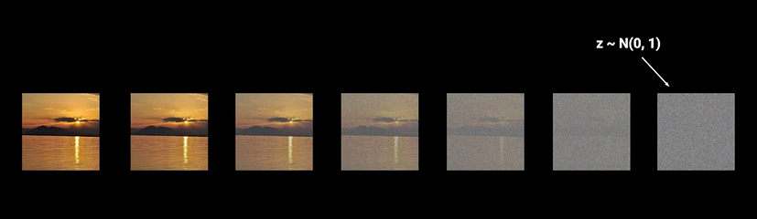
Understanding of DDPM
So as discussed in the previous slide, We have two main processes:
Forward Process: We start with the original image and step by step add more noise to the image. If we repeat this for sufficient number of steps, the image will become pure noise.
How will be add the noise?
The paper uses Normal Distribution to sample the noise. The pure noise image will follow the Normal Distribution.

Slide 31
So, we can see that going from an image to noise is fairly very simple.
But wait, what about the reverse process where you go from just noise to an image? Here comes the actual problem..
2. Reverse Process:
It involves a Neural Network learning to remove the noise from an image step by step. This way we can give the Neural Network a random noisy image sampled from the Normal Distribution and let the model gradually remove the noise step by step until we have a clear looking image.
Ok, so why are we going step by step and not generate an image from the noisy image instantly?

Slide 32
Going from noisy image to a clear looking image instantly is NOT a tractable solution and can lead to much worse outcomes. You need Neural Network to learn something.. Isn’t it?
Now the point goes to.. How does this Neural Network look like? What will be the input and output of this neural network?
First of all, let’s see what this Neural Network can predict.
The Neural Network can predict:
Mean of the noise at each time step
Predicting the original image directly
Predicting the noise in the image directly
We have already seen that predicting the original image is not a tractable solution. So we can eliminate that.
What would you select?

Slide 33
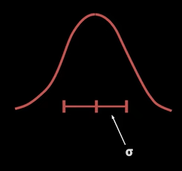
Well, both are mostly same. We just parameterize them differently. We will see this in further slides.
Most of the researchers chose third option i.e., Noise of the image and predict the noise directly.
Well, you all may be wondering why we are predicting the mean and not variance in the first option as the Normal Distribution needs mean and variance.

Slide 34
The authors of the paper decided to the fix the variance and thus there is no need to predict it since it always readily available.I will show you all in the Math Derivation part what they fixed it to.
Just as an improvement…
Can we think of learning the variance too because it may lead to the improvements in the log likelihood (loss of the Neural Network). We will see that later.
Note: We don’t employ same amount of noise at each time step in the forward process. How do we regulate that?
Schedule - Scales the mean and the variance. This ensures that the variance doesn’t explode as we add more and more noise.
This paper we are discussing employed Linear Schedule

Slide 35
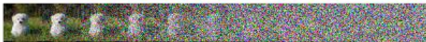
Using linear schedule, the transformation looks something like this
We will further discuss more about this and the scope of the improvement.
We are now clear what does the input and output of the Neural Network look like
Let’s have a look at the Architecture.

Slide 36
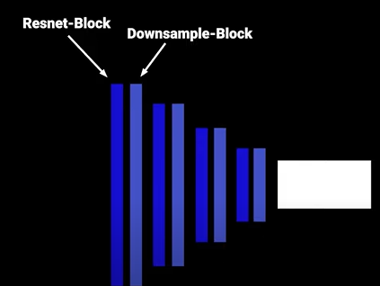
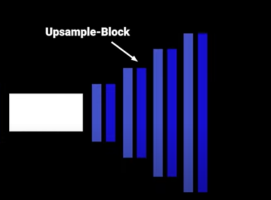
Architecture of DDPM
The Neural Network used for the reverse process looks like a U-Net Architecture.

Slide 37
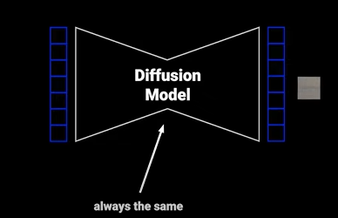
The model will be same for each timestep.
The way of telling the model at what time step we are, is done using the sinusoidal embeddings that we learned from the Transformer paper.

Slide 38
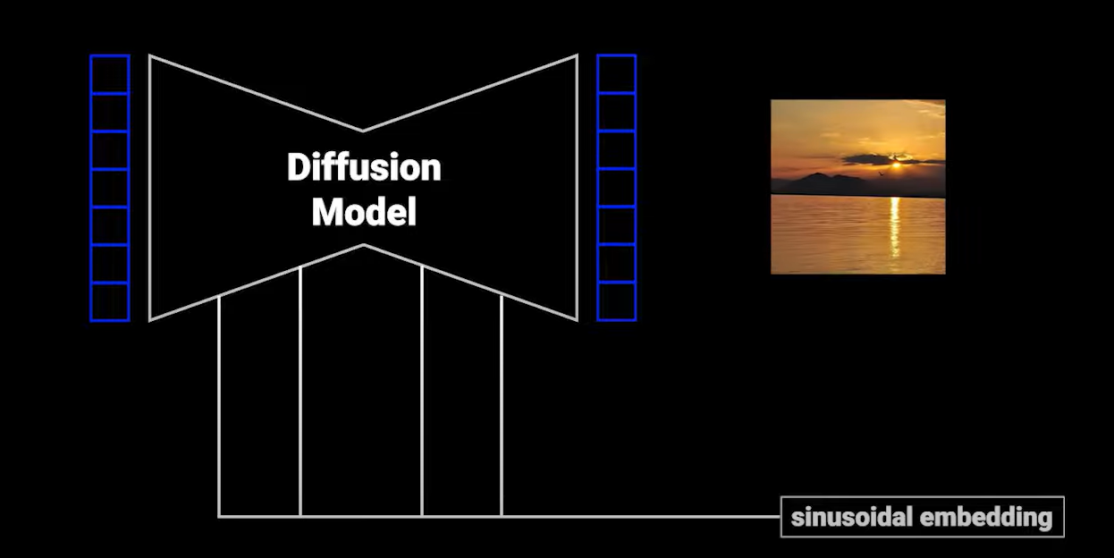
This is passed to each residual block and it is very important because forward diffusion process is using a schedule (we discussed it a little on it which scales mean and variance). With this embedding the model can remove the noise at different levels in different amount of time intervals which effects the output a lot.

Slide 39
PAPERS REFERRED
Score Based Models - https://arxiv.org/pdf/1907.05600v3
Denoising Diffusion Probabilistic Model - https://arxiv.org/pdf/2006.11239
Some improvements done by OpenAI - https://arxiv.org/pdf/2102.09672
Latent Diffusion Models - https://arxiv.org/pdf/2112.10752

Slide 40
NEXT UP
For the next presentation,
We will be going through the Math behind the working of DDPM extending some concepts we learned today and extend it to implement PyTorch based basic DDPM model.
We will be going through the improvements of the basic DDPM model like Latent Diffusion Models and some tunings to the basic DDPM along with other future scopes.

Slide 41
THANK YOU!
SEE YOU NEXT WEEK!

Slide 42
DIFFUSION MODELS
CSE 705 SEMINAR (FALL 2024) DAY 2
Presented By:
Team Sushi (Vamshi Krishna Kyatham, Xiaofeng Chen, Rahul Dasari)

Slide 43
LET’S CONTINUE WHERE WE LEFT FROM..
MATH BEHIND DDPM

Slide 44
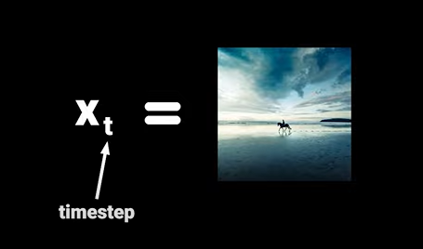
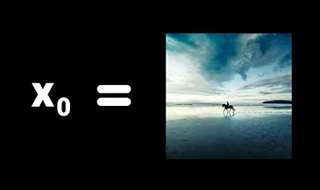
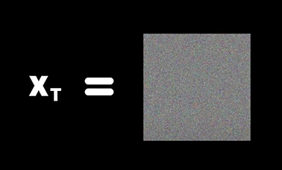
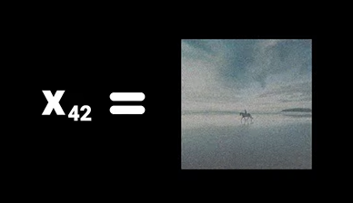
Let’s fix some Notations
For Example: The Original Image at timestep 0 is:
The image after iteratively adding noise in the forward process at timestep 42 is:
The final image after following isotropic Gaussian
Distribution:
Initially in the base paper
T was set to 1000

Slide 45
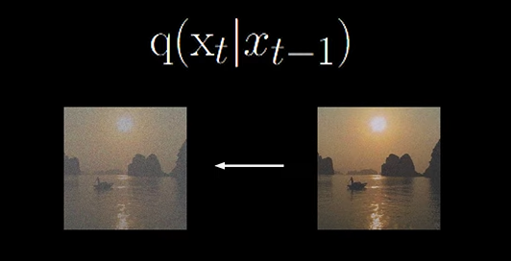
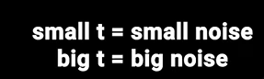
Now let’s define some functions
Forward Process: q(x_{t} | x_{t-1}) defines the forward process.
Timestep t - 1 corresponds to image with less noise and timestep t corresponds to image with more noise.

Slide 46
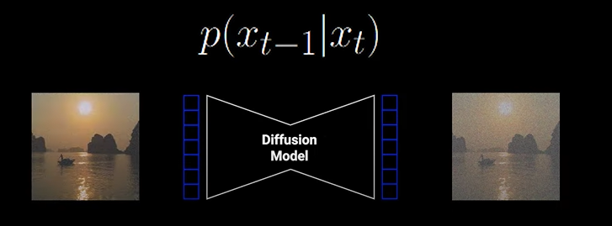
Now let’s define some functions
Reverse Process: p(x_{t-1} | x_{t}) defines the reverse process.
Timestep t - 1 corresponds to image with less noise and timestep t corresponds to image with more noise.

Slide 47
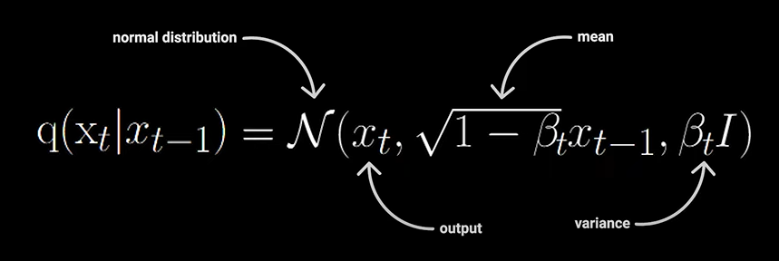
Let’s dive into the forward process
Beta refers to the schedule we discussed on the previous week. It varies between the range 0 to 1 and ensures that the data is being scaled so that the variance doesn’t explode.

Slide 48
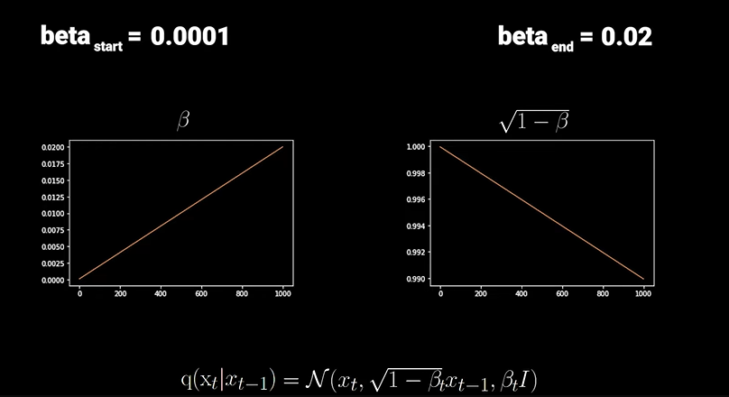
Let’s look into the Schedule
Linear Schedule: The defined start and end values of this schedule are 0.0001 and 0.02.
We can see from the graphs that we more and more scale down the image which acts as the counterpart for increasing the variance over time and keeping the variance in bound without exploding.

Slide 49
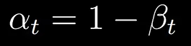
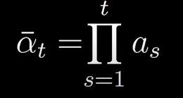
Cool, we now understand how to apply the forward step using the formula
This is for one time step. But we need to do this iteratively for 1000 timesteps which needs to repeat the formula 1000 times.
But there is an easier way to do it in one single step.
Let’s define some Notations for that:
Cumulative Product of Alpha’s till ‘t’

Slide 50



Let’s rewrite the forward process equation q(x_{t} | x_{t-1})
Epsilon follows a Normal Distribution
The final form of forward process can be written as:
You can see here that you can go from x₀ to x_{t.} directly. Now you can understand why we used cumulative alphas. We can simplify the formula.

Slide 51


Now let’s look into the reverse process:
We would need two neural networks to parameterize the Normal Distribution which we can sample from to get x_{t-1}

Slide 52


In order to have an easy time, we will start by looking at the loss function. It is a simple negative log likelihood.
We know that p(x₀) isn’t nicely computable as it depends on all the time steps coming before x₀ upto x_{T}
Keeping track of all these is not possible
One trick we can use to solve this is Variational Lower Bound

Slide 53



So we can subtract KL Divergence which is a measure how similar two distributions are which is always +ve.
We are adding because we need to minimize the loss function. But this is still not computable as well.
Apply Bayesian rule to the lower term.

Slide 54


We use joint probability in some places
We get rid of that annoying quantity.

Slide 55


Great, Now this is our variational lower bound which we can minimize.
The term at the top of second term is the forward process
The cumulative product is taken out which convert to the summation.
Later we will divide the summation to two parts. One at time step 1 and rest in another term. We will see why we did that.

Slide 56




We will apply Bayes Rule to the top term of second equation. All these terms has very high variance since we don’t know where we started from.
This is possible when it is extra conditioned with x₀
This formula also has a closed form solution which we will talk later.

Slide 57



If we didn’t remove the last term, it would have been mess.
Let’s continue.

Slide 58



Slide 59



We can ignore the first term as it indicates forward process and q has no learnable parameters.The KL DIvergence will be small because forward process converges to Normal Distribution and difference is small with a random sampled noise.We can use the third term for scaling but we can ignore that for now.
This is the closed form solution I was referring to. The derivation is similar as explained in the forward process and the final form would look like

Slide 60

Let’s focus on mean as we know variance is constant.
From forward process, we know the value of x_{t}
We can see at the end that we are subtracting random scaled noise from x_{t}

Slide 61

Now this is what our Neural Network needs to predict and the authors decided to use simple MSE

Slide 62



Substituting the mean we get
x_{t} is the input to the model. Instead of predicting this entire first term, why don't we just predict the noise?

Slide 63


Once we substitute mean and simplify we get,
The authors found that we can ignore the first scaling term for further simplification as it doesn’t effect the value much.
So Finally, we get
Finally, we can conclude that predicting the noise of the image is all what we need from the U-Net.

Slide 64




From the finding of the noise we can get back our image
Applying
Epsilon is noise sampled from random Normal

Slide 65

Some Improvement we can think of
We can improve the schedule. We saw that Linear Schedule de-structures the image at early timesteps and some steps are redundant at last. We can use Cosine Schedule for improving the adding of the noise segment.
We saw that we fixed the variance using the schedule. We can learn the variance as well using an another Neural Network.
We can explore on the Architectures following the similar principles. Why can’t we use the latent space technique of VAE’s here?
Let’s see the third step in detail.

Slide 66
LATENT DIFFUSION MODEL
Paper Link:
High-Resolution Image Synthesis
with Latent Diffusion Models

Slide 67

Denosing Diffusion Model
Sequential sampling process
Iterative refinement
Operate directly in pixel space

Slide 68
LDM helps with Limited Computationally Resource
Latent Space
Complexity reduction (focus on the important ,semantic bits of data)
Detail preservation (train in low-dimensional, computationally much more efficient space)
Cross-attention layer
Generator for general conditioning inputs in a convolutional manner

Slide 69

Perceptual compression and Semantic compression

Slide 70


Slide 71
Train Autoencoder in Adversarial Manner
Reconstruction Loss
Adversarial Loss
Log-likelihood of the discriminator Correctly classifying the real data
Regularization term

Slide 72

Cross Attention Layer

Slide 73


Conditioning mechanism in LDM
Here denotes a (flattened) intermediate representation of the UNet implementing

Slide 74


Diffusion models and Latent diffusion model
Diffusion Model
Latent Diffusion Model

Slide 75

Latent diffusion model Downsampling Experiments

Slide 76


Latent diffusion model Downsampling Experiments
CelebA-HQ ImageNet
Figure 7. Comparing LDMs with varying compression on the CelebA-HQ (left) and ImageNet (right) datasets. Different markers indicate {10, 20, 50, 100, 200} sampling steps using DDIM, from right to left along each line. The dashed line shows the FID scores for 200 steps, indicating the strong performance of LDM- {4-8}. FID scores assessed on 5000 samples. All models were trained for 500k (CelebA) / 2M (ImageNet) steps on an A100

Slide 77

Qualitative Results On Each Dataset

Slide 78

Unconditional Image generation with LDM

Slide 79

Text-to-Image Conditioning

Slide 80

Image generation with Latent diffusion model

Slide 81


Layout to Image Synthesis
Figure 8. Layout-to-image synthesis with an LDM on COCO [4], see Sec. 4.3.1. Quantitative evaluation in the supplement D.3.
Figure 9. More samples from our best model for layout-to-image synthesis, LDM-4, which was trained on the Open Images dataset and fine tuned on the COCO dataset. Samples generated with 100 DDIM steps and η = 0. Layouts are from the COCO validation set.

Slide 82

Convolutional Sampling Beyond 256
2

Slide 83

Super-Resolution with Latent Diffusion

Slide 84

Super-Resolution with Latent Diffusion

Slide 85

Super-Resolution with Latent Diffusion

Slide 86



Inpainting with Latent Diffusion

Slide 87

U-Net Skip Connection

Slide 88
PAPERS REFERRED
Score Based Models - https://arxiv.org/pdf/1907.05600v3
Denoising Diffusion Probabilistic Model - https://arxiv.org/pdf/2006.11239
For Math Derivation - https://lilianweng.github.io/posts/2021-07-11-diffusion-models/, Outlier
Some improvements done by OpenAI - https://arxiv.org/pdf/2102.09672
Latent Diffusion Models - https://arxiv.org/pdf/2112.10752

Slide 89
THANK YOU!

